Slide 1
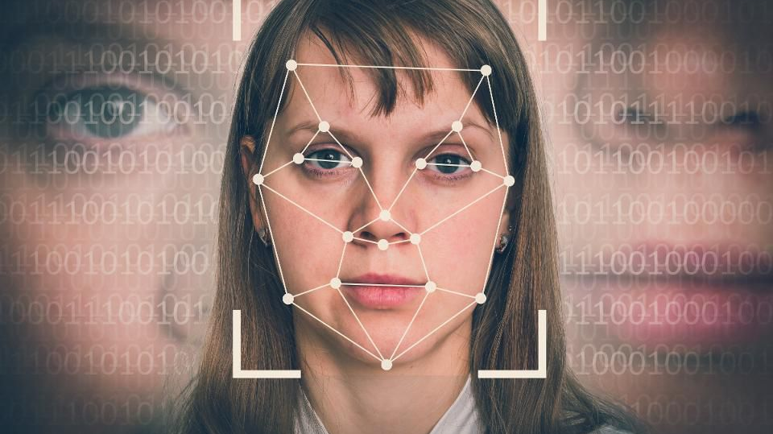
Data Science Prospects
Halak Patel, Huma Ghiya, Mohamed Obaidullah, Jeanette Cross, Harneet Kapil

Slide 2
Topics to be Covered:
Project Inspiration
Demo
Data & Technology
Post-Mortem
Lesson Learned

Slide 3
Project Inspiration: Facial Recognition X Artificial Intelligence
Interesting and relevant topic in today’s society
Applying DS learning into a bigger perspective
Many uses of facial recognition :
Crime
Unlocking / Security for personal smart phone devices
Aid in forensic investigations
Social Media Platforms

Slide 4
In the next 10-12 min, we will discuss…
Reasoning behind Data Science
Deeper dive into the usage of Data Science
Data Science Prospects
Facial Recognition!
Help in explaining where we can fit in as Data Scientists
Demonstrate understanding of Data Science concepts

Slide 5

Demo
Tableau – Data Science Dash Board
Face Recognition Demo

Slide 6
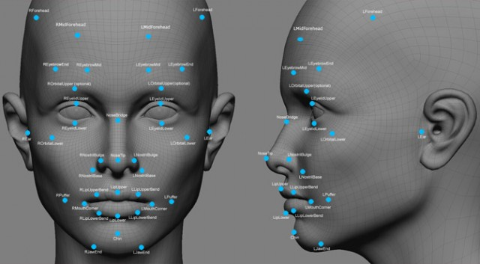
The Data Source
Kaggle data
https://www.kaggle.com/kaggle/kaggle-survey-2017
Real life Data
Personal Picture and information

Slide 7
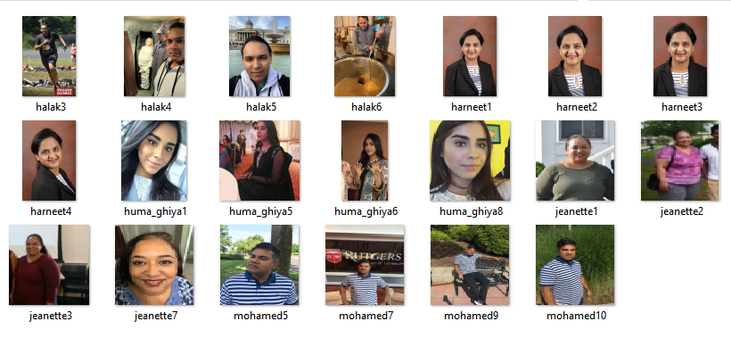
Our Real-Life Data!

Slide 8
Methods and Applications
Tableau
Python
Keras Model
SK Learn
NumPy
Jupyter Notebook

Slide 9

Post Mortem
Time was a constraint to elaborate the Face Recognition application
Application to load faces
Connect the Tableau and Face Recognition
Survey data is as of 2017
Conducted by Kaggle for 16K respondents
Landing on a topic to leverage Data Science Learning

